Slide 1

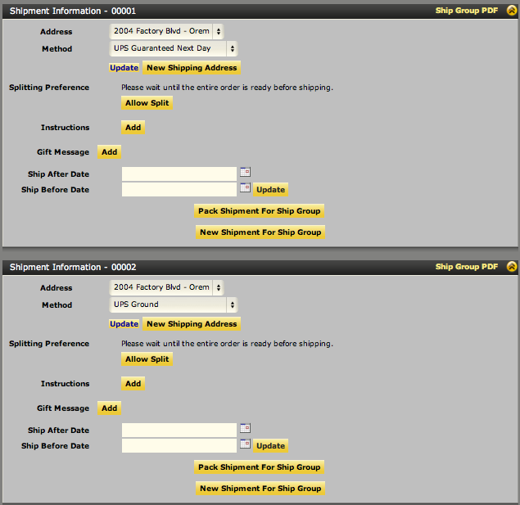
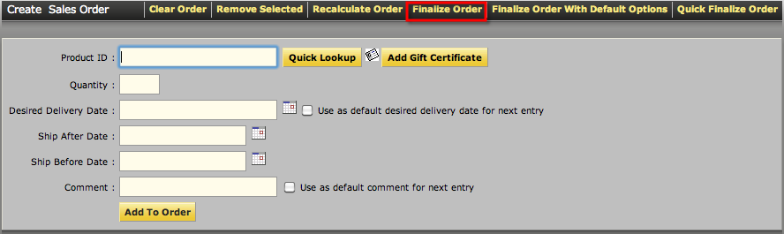
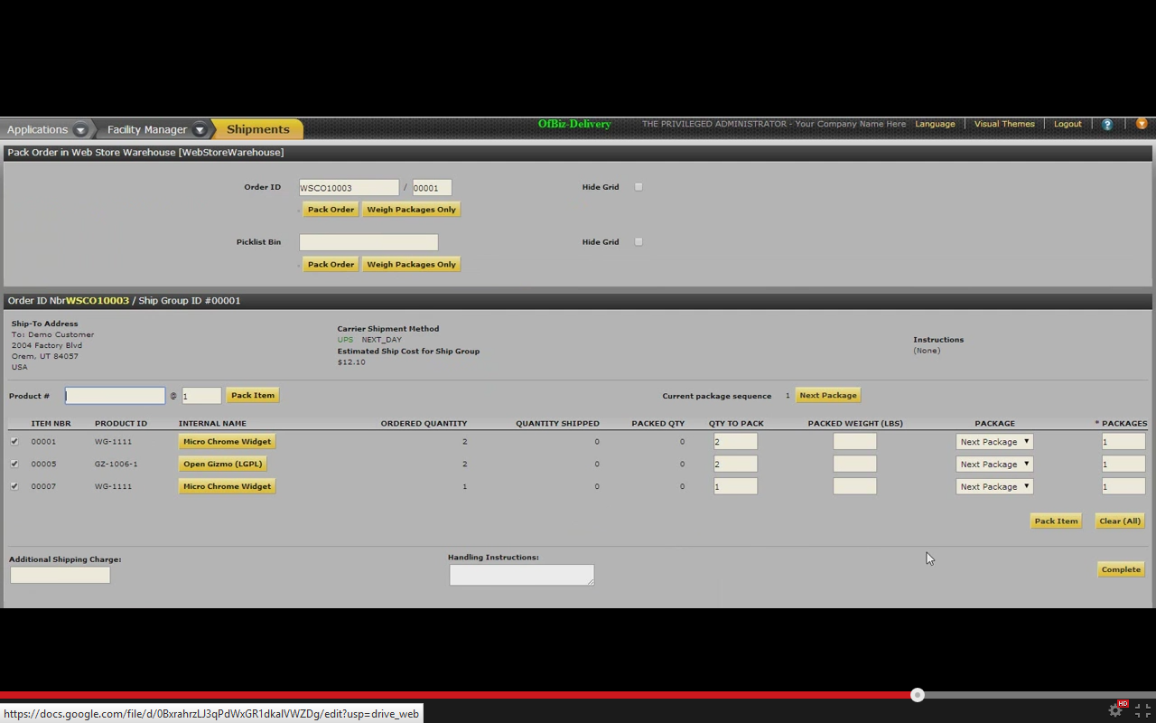

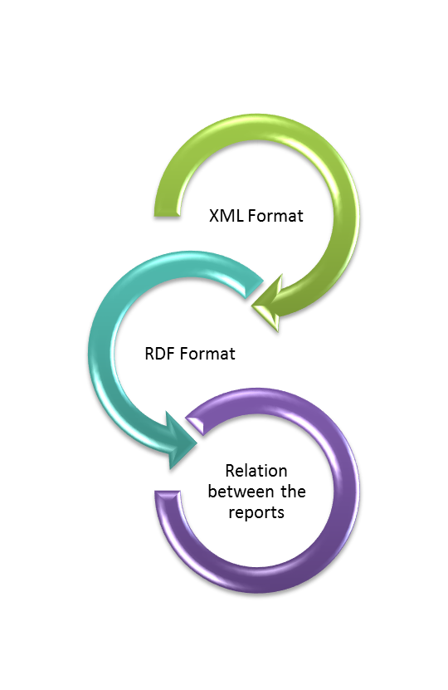

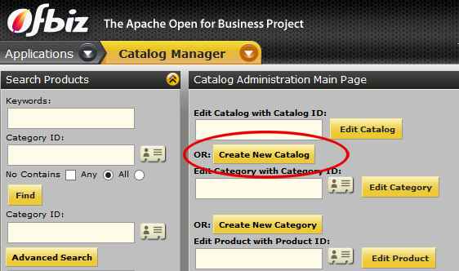
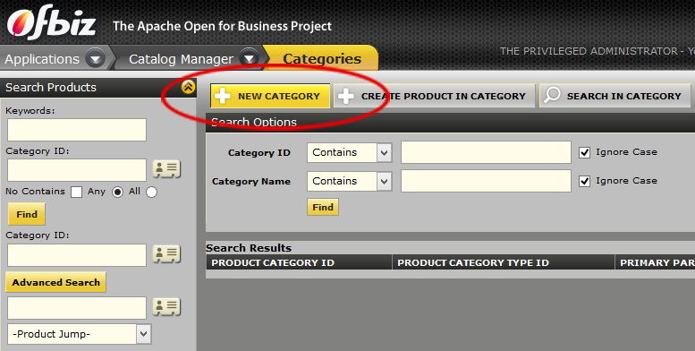
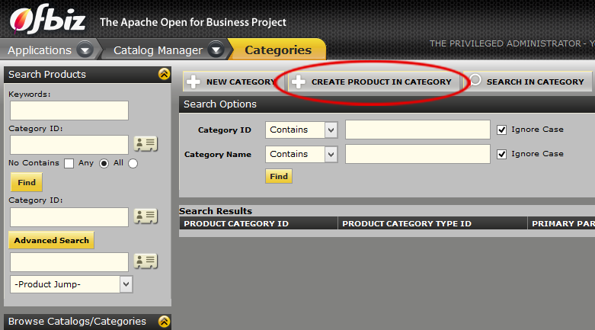
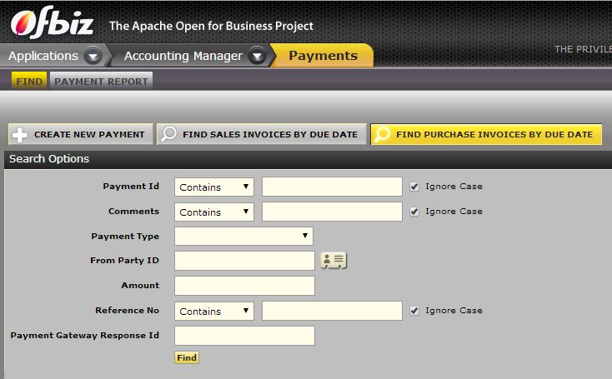
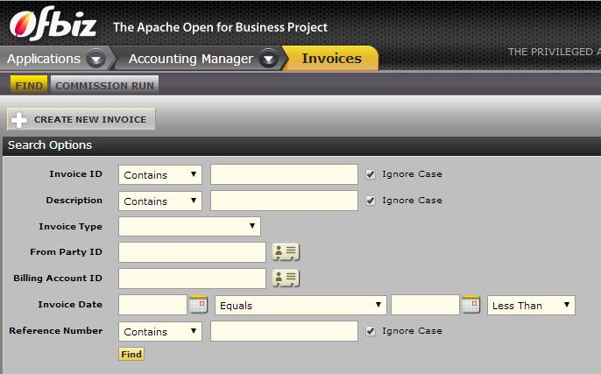
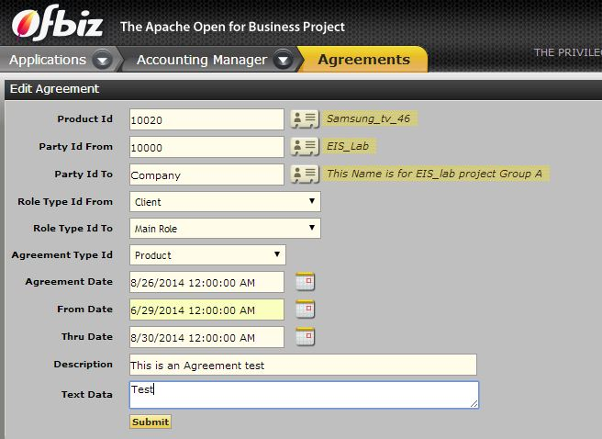


Implementation of E-Commerce
workflows using Apache OFBiz ERP
Logo/Icon
Authors:
Sareh Ghayoomi – Narges Kasaeizadeh – Ali Khoramshahi – Vikramjit Singh – Parsa Vali
Summer Semester 2014
Supervised By:
Natalja Friesen
About the Project
Delivery Workflow
Goals: Implementing three workflows (Shopping, Payment, Delivery).
Requirements: Server machine, Apache OFBiz ERP system.
Output: RDF format reports.
Customer Side:
Shopping
Payment
Delivery
Order received
Order is packed
Shipping notification
Shipping the changed order
Returning order
Payment return notification
Changing Order
E-commerce
Client Side:
E-commerce or eCommerce stands for Electronic commerce which involves communications and doing business electronically through the internet. By using Internet and WWW services, organizations are implementing PDM, SCM and CRM[1].
ERP and Apache
1- Multiple shipment
2- Finalizing order
3- Packaging order
Enterprise Resource Planning (ERP) - business management software to collect, store, manage and interpret data from many business activities: product planning, manufacturing, inventory management, shipping and payment.
Most popular ERP systems: ERP5, Open ERP, SAP suite 1.
Apache OfBiz- an open source ERP system provided by Apache Software Foundation
ERP
CRM
Accounting
Sales
Human Resource
Production
Procurement
Converting Reports to RDF format
Finalized OFBiz’s reports are generated in XML format.
The R2RML tool (http://x2r.aut.ac.nz/x2r.jsp) is used to convert XML to RDF format.
RDF report data can be easily integrated and linked with data about products, companies and so on.
Shopping- Workflow
So how to start ?
Customer Side:
Catalog browsing
Sign in /
Sign up
Product searching
Add/Select product
Checkout
Understanding ERP, E-Commerce, OFBiz and the relation between them.
Installing Apache OFBiz and the related software.
Learning and Understanding the Apache OfBiz and then Implementing E-Commerce on it.
Client Side:
1- Creating Catalog
2- Creating Category
Future Work
3- Creating Product
Other workflows can also be implemented which are:
Facility and Warehouse Management
People and Group Management
Human resources (HR)
Sales Force Automation
Accounting (Agreements, Invoicing, Vendor Management, General Ledger)
Payment Workflow
Customer Side:
Authentication check
Sign in /
Sign up
Shipping method selection
Address specification
Payment method selection
Successful payment notification
Virtual Machine Description
Client Side:
Hostname: vm-ofbiz
Software installed:
Installed on: EIS3
Ubuntu 14.04 LTS 64bit OS
1GB RAM
2 CPUs.
jdk1.7 (/usr/local/java)
Apache-ant-1.9.4 (/usr/share/ant)
Apache-ofbiz-11.04.04 (/usr/lib/apache-ofbiz-11.04.04)
Local Access:
User: eis-user
Password: E1sofBiz2014
Remote Access:
Partner ID: 491395165
Password: E1sofBiz2014
1- Find existing payment
2- Creating Invoices
3- Creating Agreement
Resources :
[1] : Sharma, H., Lavania, D., & Gupta, N. (2011, June 1). ERP E-BUSINESS = An emerging relationship. Retrieved September 15, 2014.
EIS
Enterprise
Information Systems

